Slide 1

ABC Call Volume Trend Analysis
By
Stan Pereira

Slide 2
Project Description
A Customer Experience (CX) team plays a crucial role in a company. They analyze customer feedback and data, derive insights from it, and share these insights with the rest of the organization. This team is responsible for a wide range of tasks, including managing customer experience programs, handling internal communications, mapping customer journeys, and managing customer data, among others.
One of the key roles in a CX team is that of the customer service representative or call center agent. These agents handle various types of support, including email, inbound, outbound, and social media support.
The dataset provided spans 23 days and includes various details such as the agent's name and ID, the queue time, the time and duration of the call and the call status.
Inbound customer support, which is the focus of this project, involves handling incoming calls from existing or prospective customers. The goal is to attract, engage, and delight customers, turning them into loyal advocates for the business.

Slide 3
Approach
Understand Data
Analyze Data
Visualize Data
Clean Data
Understand the dataset, features and impact on other columns.
Identify Missing Data and Deal with it Appropriately.
Analyze the data to find various relationships between features to derive conclusions.
Visualize the data using Tables, Charts and Dashboards.

Slide 4
Tech Stack Used
Microsoft Excel 2010 Version 14.0.7628.5000
Ability to perform calculations, data analysis, data visualization, data transformation, and data cleaning with Excel tools and functions.
Transform and clean data with features like Power Query and Flash Fill.
Code to automate tasks and customize functions with VBA (Visual Basic for Applications).
Availability of free templates and code to customize and automate Excel.

Slide 5
Understand Data
Table Information (Original)
Total Rows | 117988
Total Columns | 13
Total Blanks | 47877
Duplicates | 0
Columns | Blank Count
Agent_Name | 0
Agent_ID | 0
Customer_Phone_No | 0
Queue_Time(Secs) | 0
Date_&_Time | 0
Time | 0
Time_Bucket | 0
Duration(hh:mm:ss) | 0
Call_Seconds (s) | 0
Call_Status | 0
Wrapped _By | 47877
Ringing | 0
IVR _Duration | 0

Slide 6
Clean Data
Table Information (Clean)
Total Rows | 117988
Total Columns | 13
Total Blanks | 0
Duplicates | 0
Column Name | Format Change
Agent_Name | Converted to Text
Agent_ID | Converted to Text
Customer_Phone_No | Converted to Text
Queue_Time(Secs) | Converted to Number without Decimal
Date_&_Time | Converted to "dd-mmm-yyyy hh:mm:ss" Format
Time | Converted to Number without Decimal
Time_Bucket | Converted to Text
Duration(hh:mm:ss) | No Format Change
Call_Seconds (s) | Converted to Number without Decimal
Call_Status | Converted to Text
Wrapped _By | Converted to Text
Ringing | Converted to Text
IVR _Duration | No Format Change
Blank/Null Value Update
Wrapped By | Call Status | Count | New Value
Blank | Abandon | 34403 | Not Available
Blank | Answered | 13362 | Agent
Blank | Transfer | 112 | Agent
Value Changes
Column Name | Old Value | New Value
Customer Phone No. | XXXXX | XXXXXXXXXX
Customer Phone No. | CzentXXXXX | No Change as this could be a Special Number made using the alphabets associated with the numbers on a dialpad (CZENT = 29368)

Slide 7

Analyze & Visualize Data

Slide 8
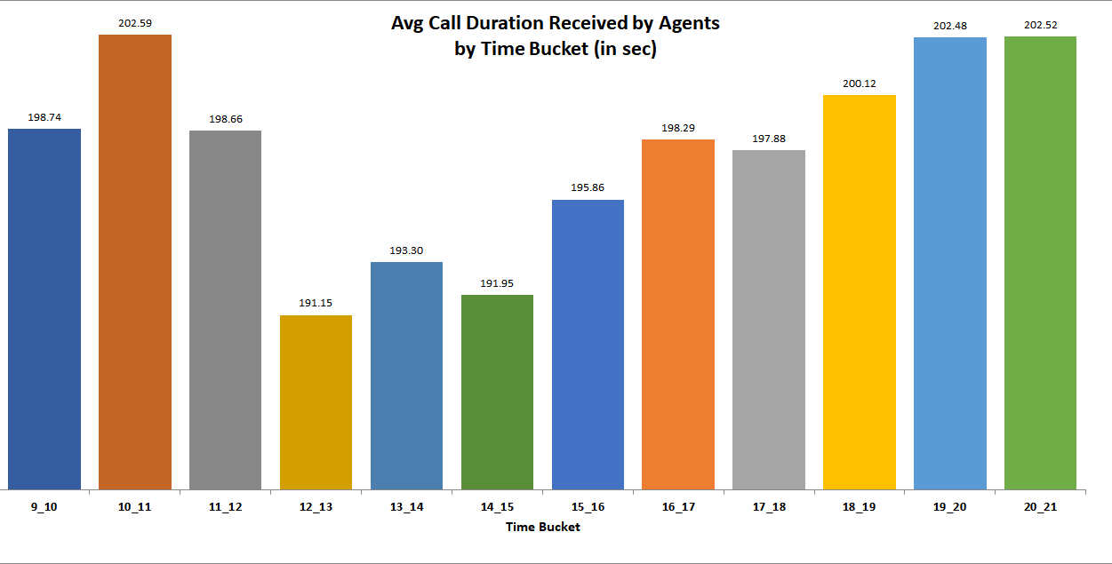
Average Call Duration: Determine the average duration of all incoming calls received by agents. This should be calculated for each time bucket. Your Task: What is the average duration of calls for each time bucket?
Avg. Call Duration : 196.96 sec

Slide 9
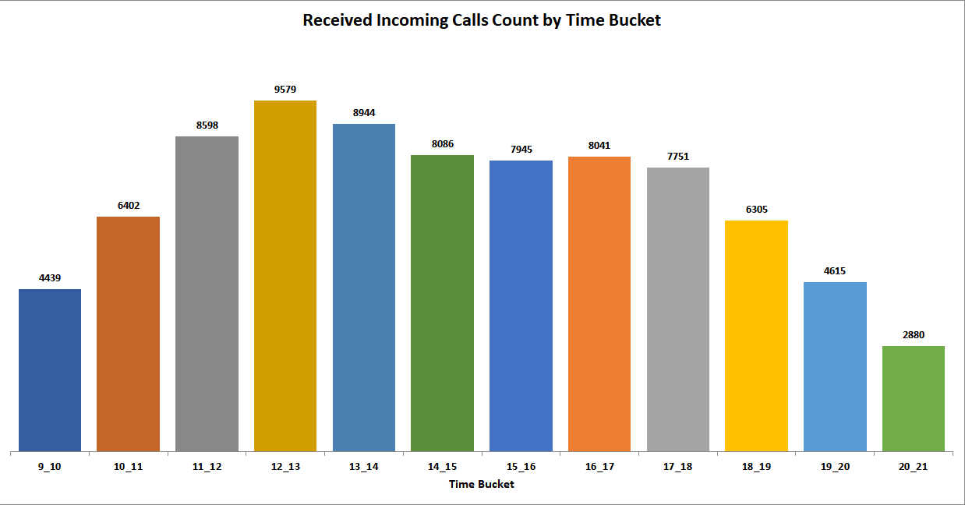
Call Volume Analysis: Visualize the total number of calls received. This should be represented as a graph or chart showing the number of calls against time. Time should be represented in buckets (e.g., 1-2, 2-3, etc.). Your Task: Can you create a chart or graph that shows the number of calls received in each time bucket?

Slide 10
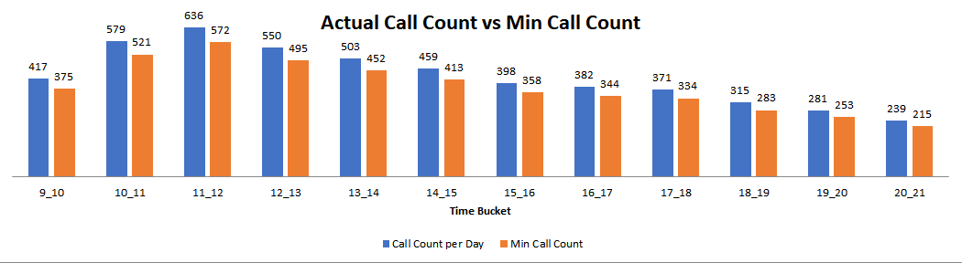
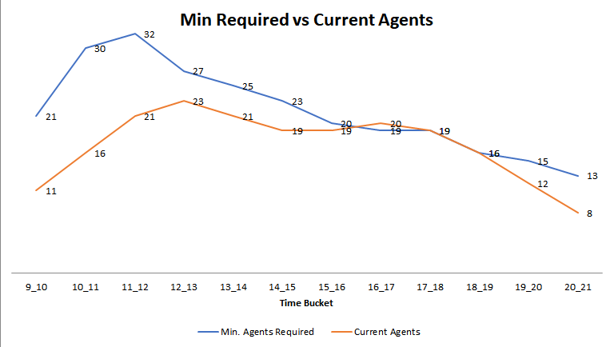
Manpower Planning: The current rate of abandoned calls is approximately 30%. Propose a plan for manpower allocation during each time bucket (from 9 am to 9 pm) to reduce the abandon rate to 10%. Your Task: What is the minimum number of agents required in each time bucket to reduce the abandon rate to 10%?

Slide 11
Night Shift Manpower Planning: Customers also call ABC Insurance Company at night but don't get an answer because there are no agents available. This creates a poor customer experience. Assume that for every 100 calls that customers make between 9 am and 9 pm, they also make 30 calls at night between 9 pm and 9 am. The distribution of these 30 calls is as follows: Your Task: Propose a manpower plan for each time bucket throughout the day, keeping the maximum abandon rate at 10%.
Assumptions and Calculations
Total Days | 30 days
Working Days in week | 6 days
Unplanned Leaves per month | 4 days
Working Hours in day | 9
Lunch and Breaks (in hrs) | 1.5
Actual Working Hours (AWH) | 7.5
Occupancy %age of AWH | 60%
Occupancy (in hrs) | 4.50
Non-Occupancy (in hrs) | 4.50
Non-Occupancy %age | 50%
Waiting Probability | 100%
Abandon Rate | 10%
Shrinkage (4 days Unplanned & 4 Days Weekly Off) | 26.67%
Average Call Duration for 2100 to 0900 hrs is an assumption based on actual data

Slide 12
Night Shift Manpower Planning: Customers also call ABC Insurance Company at night but don't get an answer because there are no agents available. This creates a poor customer experience. Assume that for every 100 calls that customers make between 9 am and 9 pm, they also make 30 calls at night between 9 pm and 9 am. The distribution of these 30 calls is as follows: Your Task: Propose a manpower plan for each time bucket throughout the day, keeping the maximum abandon rate at 10%.
Time Bucket | Average Call Duration | Call Distribution | Call Count per Day | Abandon Rate | Min Call Count | Max Calls that can be received | Min. Agents Required | Non-Occupancy %age (60% of 7.5 hrs + 1.5 hrs Breaks) | Agents required after taking into account of occupancy | Shrinkage (8 days in a month - 4 unplanned and 4 w/off) | Agents Required per time bucket
9_10 | 198.74 |  | 417 | 10% | 375 | 18 | 21 | 50% | 42 | 26.67% | 58
10_11 | 202.59 |  | 579 | 10% | 521 | 18 | 30 | 50% | 60 | 26.67% | 82
11_12 | 198.66 |  | 636 | 10% | 572 | 18 | 32 | 50% | 64 | 26.67% | 88
12_13 | 191.15 |  | 550 | 10% | 495 | 19 | 27 | 50% | 54 | 26.67% | 74
13_14 | 193.30 |  | 503 | 10% | 452 | 19 | 25 | 50% | 50 | 26.67% | 69
14_15 | 191.95 |  | 459 | 10% | 413 | 19 | 23 | 50% | 46 | 26.67% | 63
15_16 | 195.86 |  | 398 | 10% | 358 | 18 | 20 | 50% | 40 | 26.67% | 55
16_17 | 198.29 |  | 382 | 10% | 344 | 18 | 19 | 50% | 38 | 26.67% | 52
17_18 | 197.88 |  | 371 | 10% | 334 | 18 | 19 | 50% | 38 | 26.67% | 52
18_19 | 200.12 |  | 315 | 10% | 283 | 18 | 16 | 50% | 32 | 26.67% | 44
19_20 | 202.48 |  | 281 | 10% | 253 | 18 | 15 | 50% | 30 | 26.67% | 41
20_21 | 202.52 |  | 239 | 10% | 215 | 18 | 13 | 50% | 26 | 26.67% | 36
21_22 | 196.96 | 3 | 154 | 10% | 139 | 18 | 8 | 50% | 16 | 26.67% | 22
22_23 | 196.96 | 3 | 154 | 10% | 139 | 18 | 8 | 50% | 16 | 26.67% | 22
23_00 | 196.96 | 2 | 103 | 10% | 92 | 18 | 6 | 50% | 12 | 26.67% | 17
00_01 | 196.96 | 2 | 103 | 10% | 92 | 18 | 6 | 50% | 12 | 26.67% | 17
01_02 | 196.96 | 1 | 51 | 10% | 46 | 18 | 3 | 50% | 6 | 26.67% | 9
02_03 | 196.96 | 1 | 51 | 10% | 46 | 18 | 3 | 50% | 6 | 26.67% | 9
03_04 | 196.96 | 1 | 51 | 10% | 46 | 18 | 3 | 50% | 6 | 26.67% | 9
04_05 | 196.96 | 1 | 51 | 10% | 46 | 18 | 3 | 50% | 6 | 26.67% | 9
05_06 | 196.96 | 3 | 154 | 10% | 139 | 18 | 8 | 50% | 16 | 26.67% | 22
06_07 | 196.96 | 4 | 205 | 10% | 185 | 18 | 11 | 50% | 22 | 26.67% | 30
07_08 | 196.96 | 4 | 205 | 10% | 185 | 18 | 11 | 50% | 22 | 26.67% | 30
08_09 | 196.96 | 5 | 256 | 10% | 231 | 18 | 13 | 50% | 26 | 26.67% | 36

Slide 13
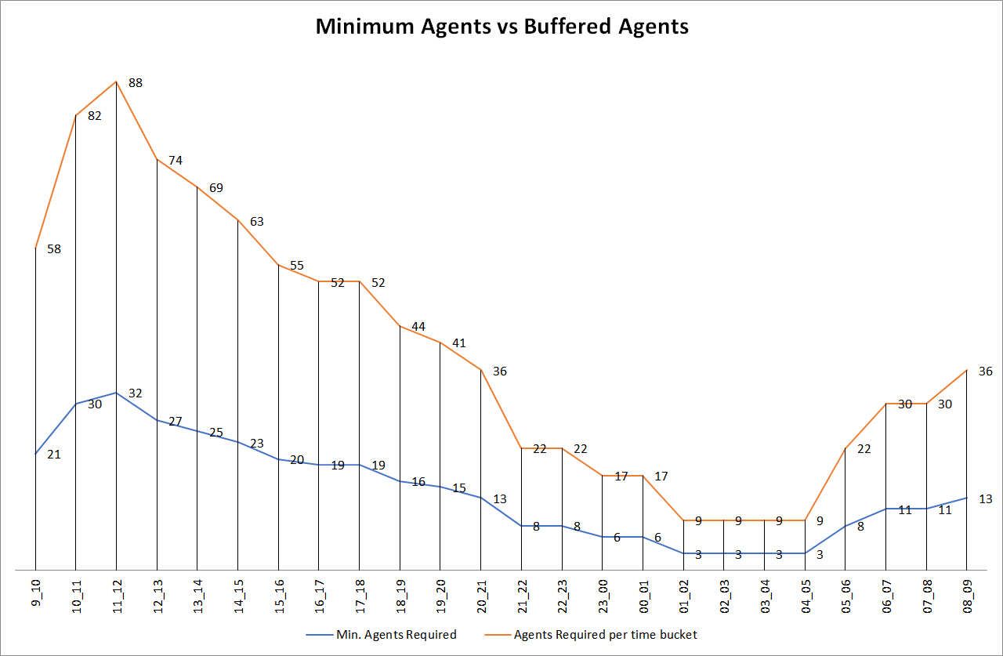
Night Shift Manpower Planning: Customers also call ABC Insurance Company at night but don't get an answer because there are no agents available. This creates a poor customer experience. Assume that for every 100 calls that customers make between 9 am and 9 pm, they also make 30 calls at night between 9 pm and 9 am. The distribution of these 30 calls is as follows: Your Task: Propose a manpower plan for each time bucket throughout the day, keeping the maximum abandon rate at 10%.

Slide 14
Summary
This project involved research on Time Series and Manpower Planning at Call Centres.
Most of the analysis was done by using Pivot Tables and Formulas.
In Statistics, a lot of research was done on how a Call Centre Manpower Planning is done. New concepts like Erlang Formula was researched and understood. This helped understand better how to solve the problem.
Overall, though the project started out easy and familiar, the major challenge was the Manpower planning which required a lot of research and learning.
Link to Excel File
Call Volume Trend Analysis (Excel File)

Slide 15

THANK YOU

